Slide 1


ECEN 403 Status Update Team 60: Solar Lighting System Josh George, Lyric Haylow, Jeb Malek Sponsor :Dr. Jang

Slide 2
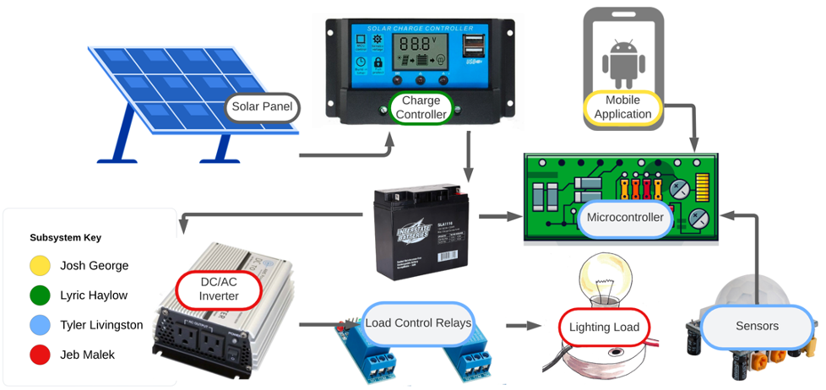
Problem Overview
For our project, we will design a home lighting system that operates a variety of lights throughout both an inside foyer and an outside patio. The separate parts for the system to be considered are the battery, power conversion and regulation, mobile application functionality, BT microcontroller, and motion and light sensors for automated switching.

Slide 3
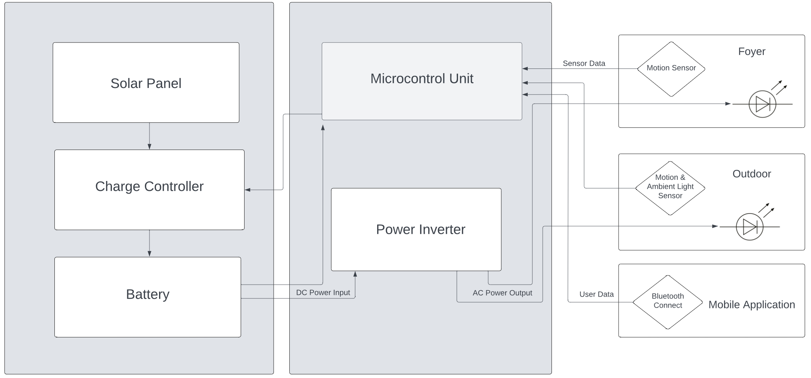
Subsystem Description

Slide 4
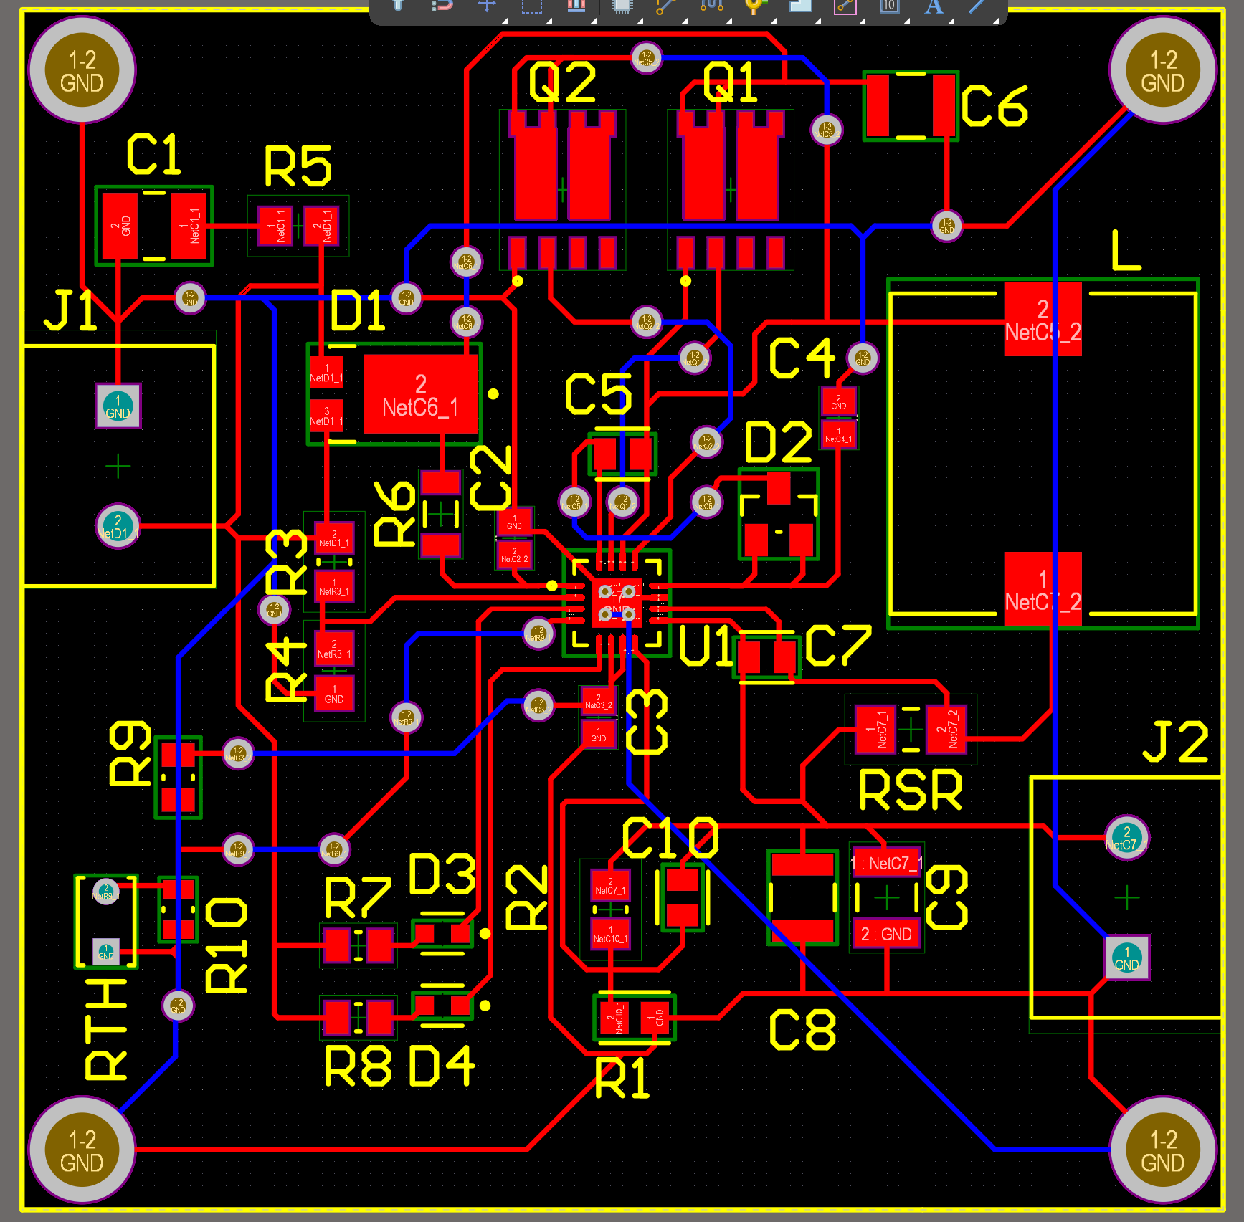
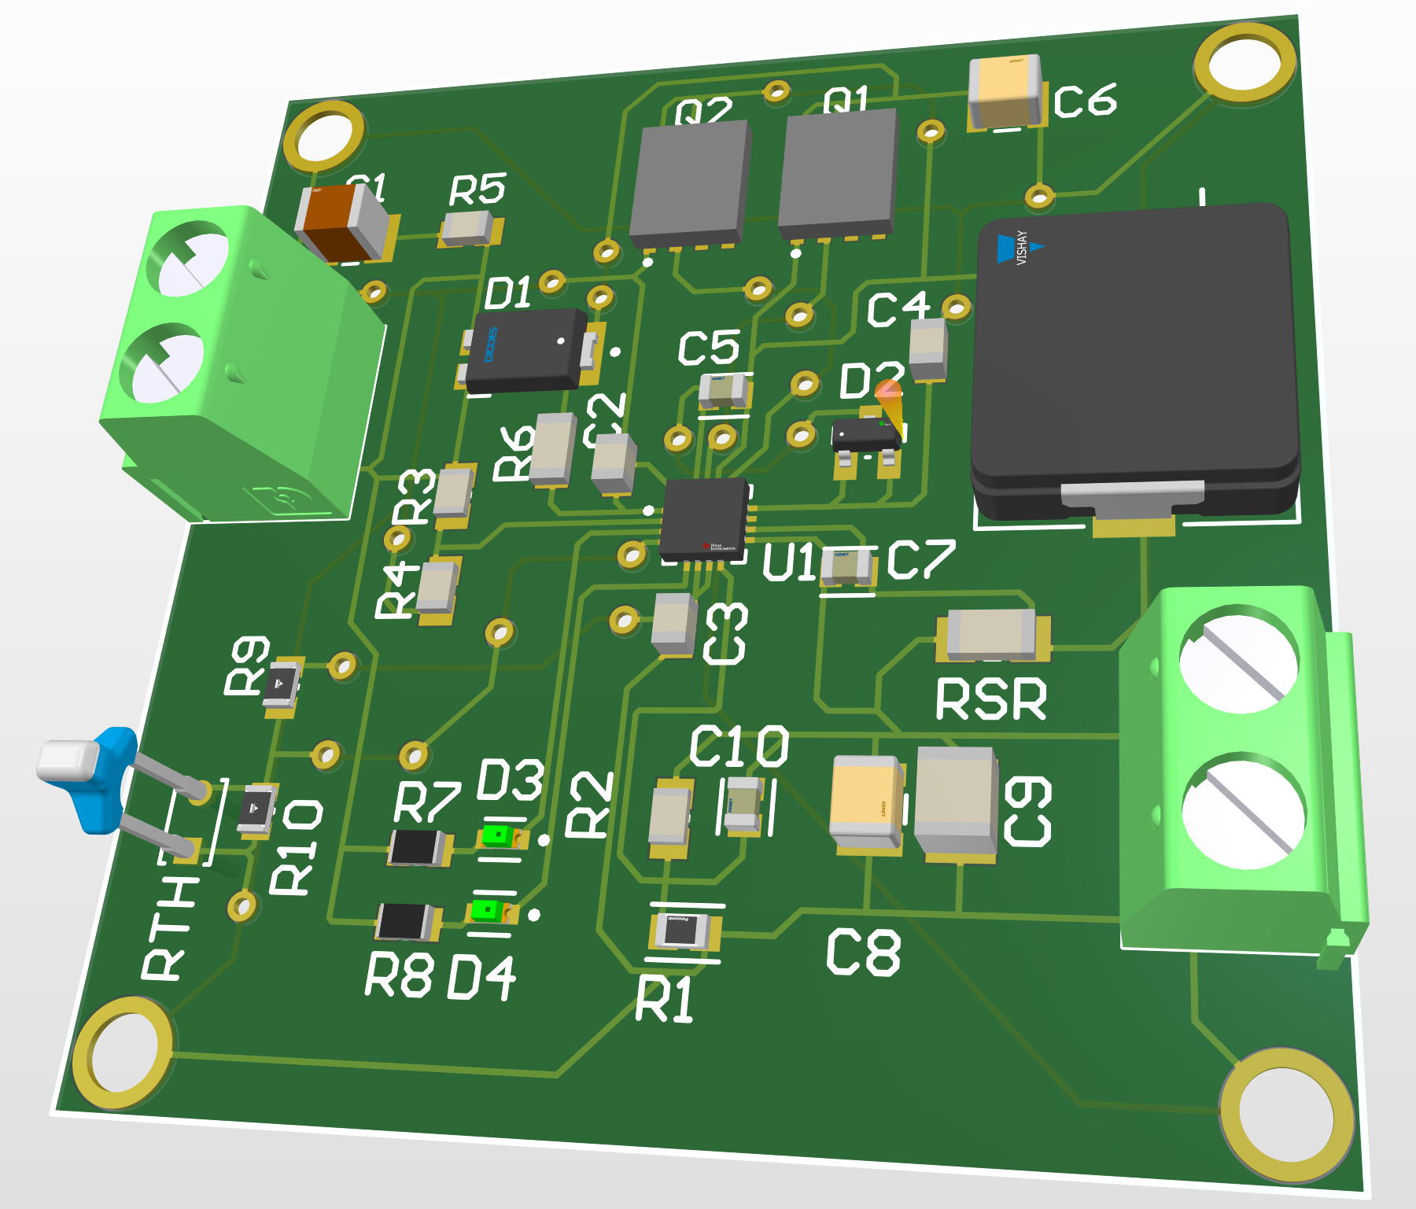
Engineering Accomplishments
Researched an appropriate design for controlling voltage and current to battery.
Designed a Schematic with component values fit for our battery and solar panel.
Fully designed a PCB since last presentation, ordered the board.
Ordered relevant parts. Parts arrived Monday.
Began preparing procedure for testing the board. Finding values and procedure techniques for testing the board with test load and input sin waves.
Began Soldering.

Slide 5
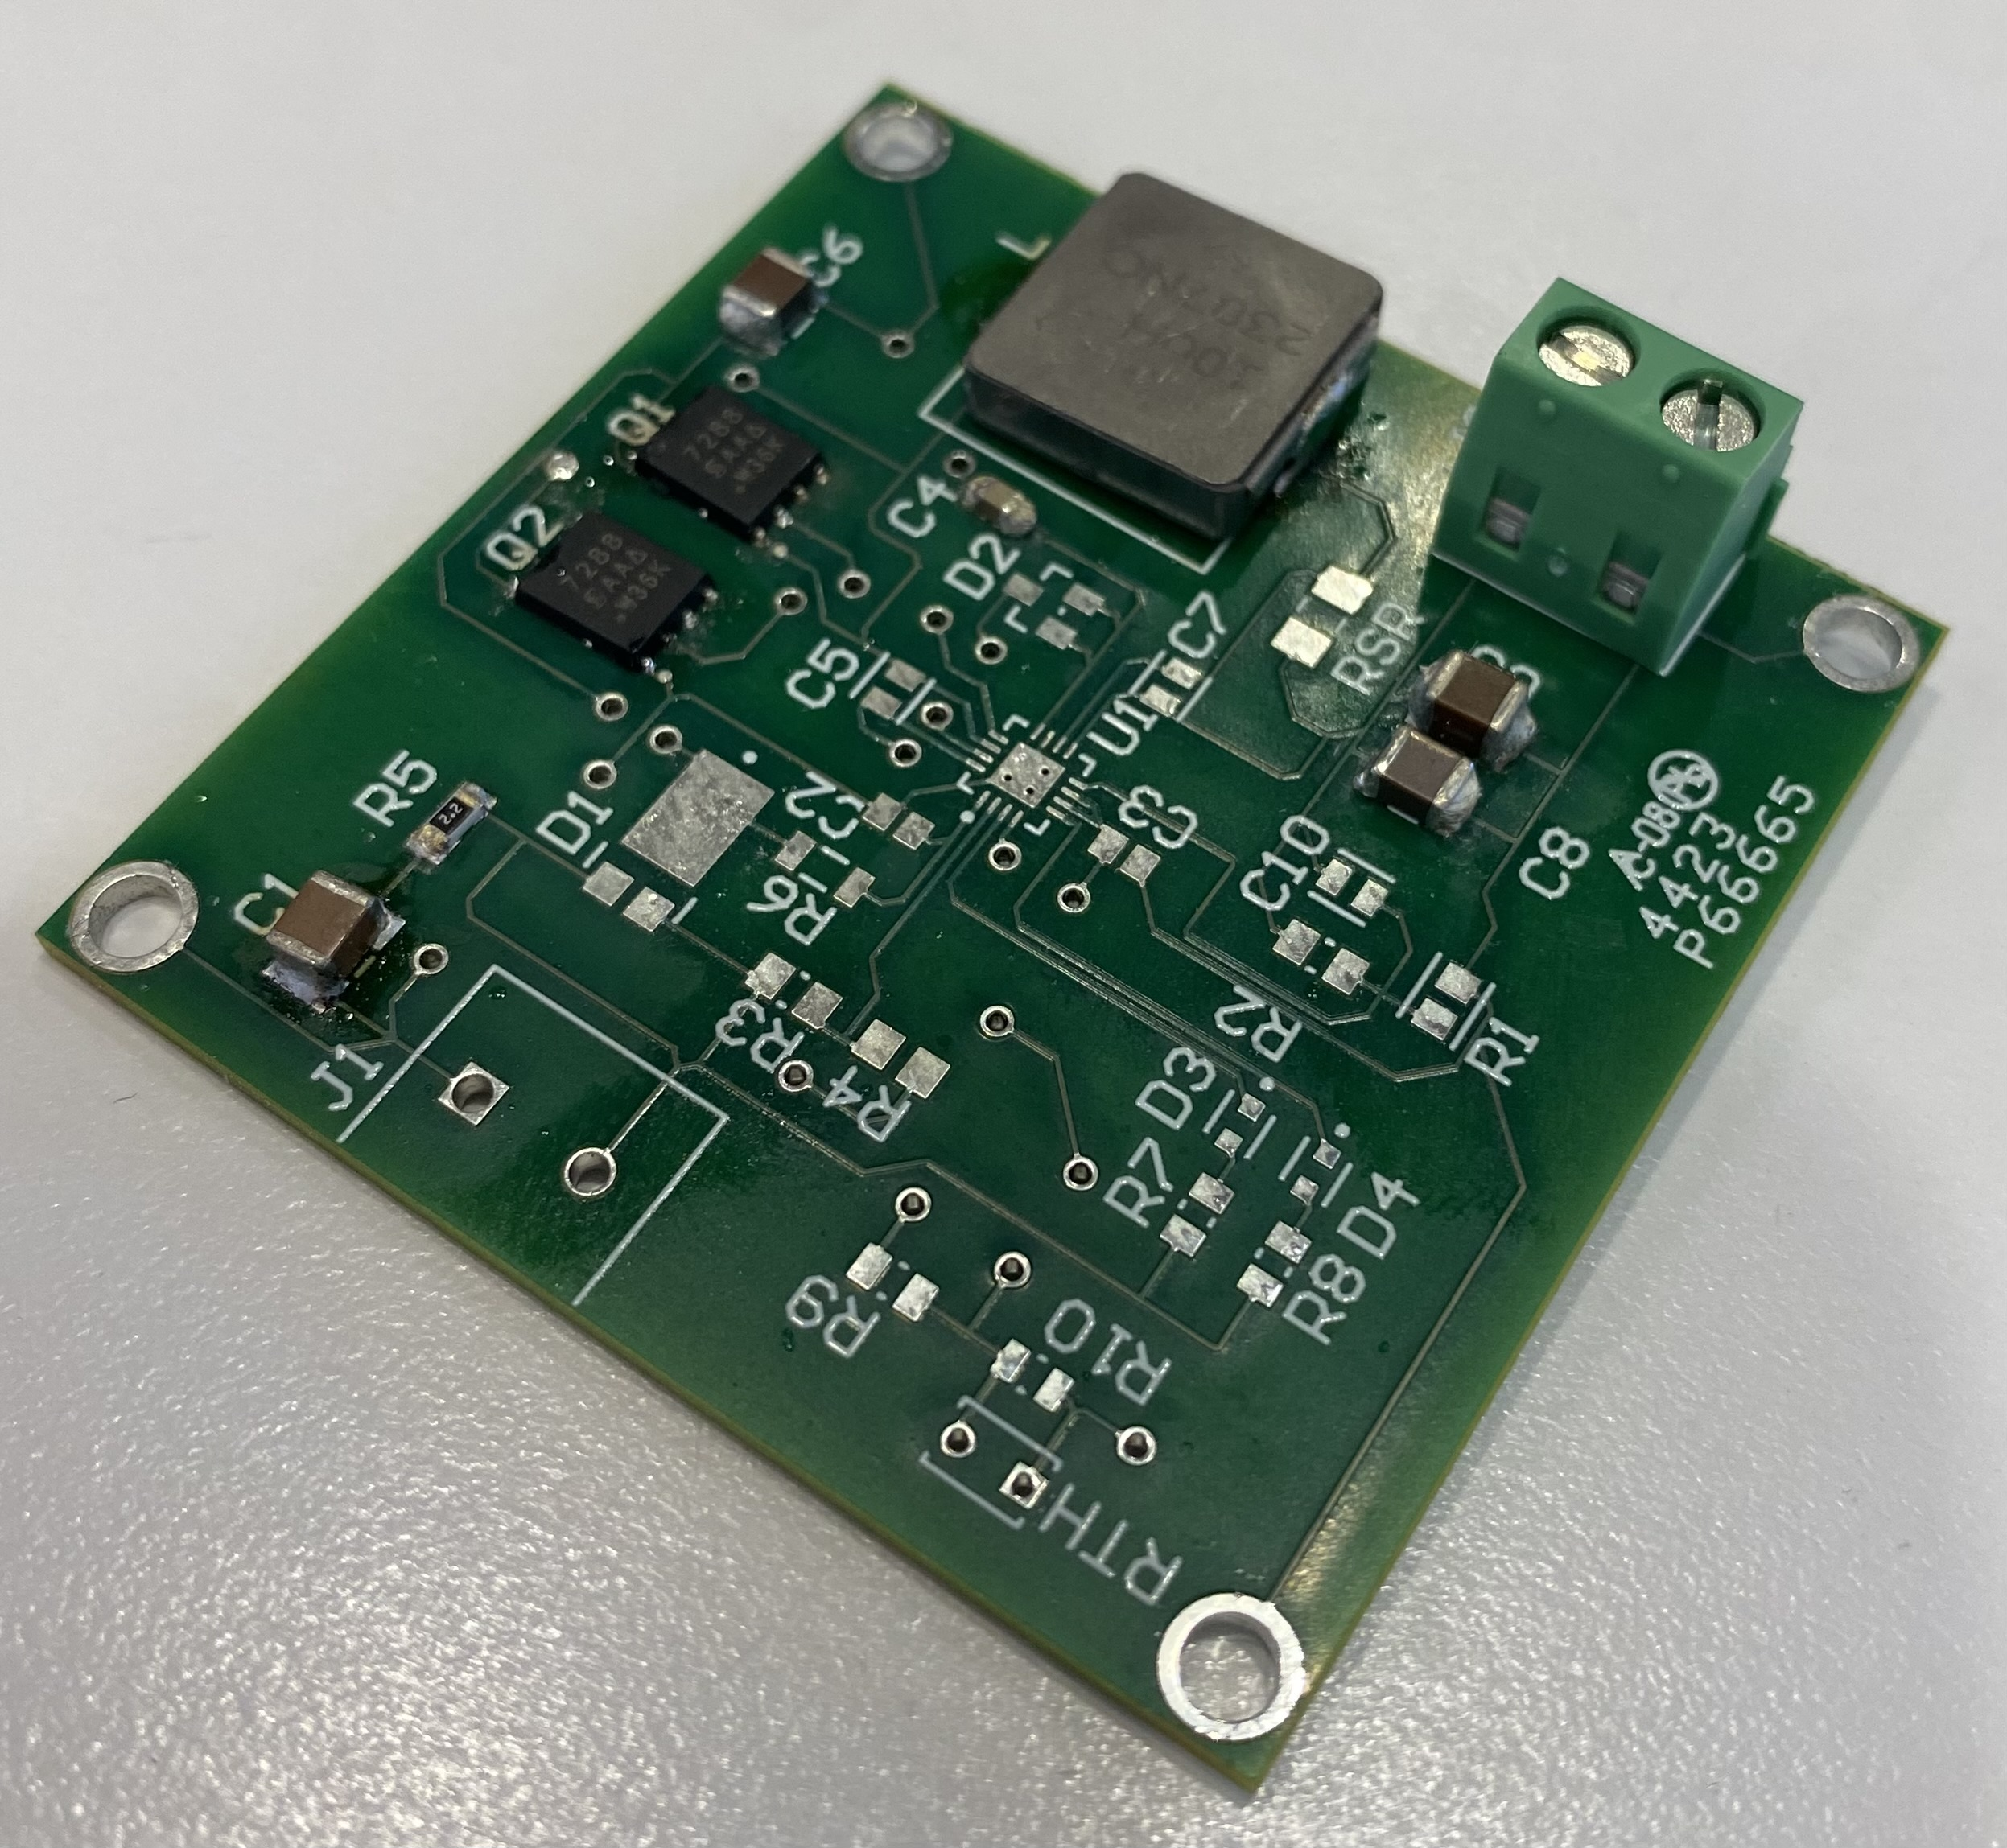
Things to do till Demo
Finish Soldering.
Test running current through board.
Test limit of output current to battery.
Test highest voltage input available.

Slide 6
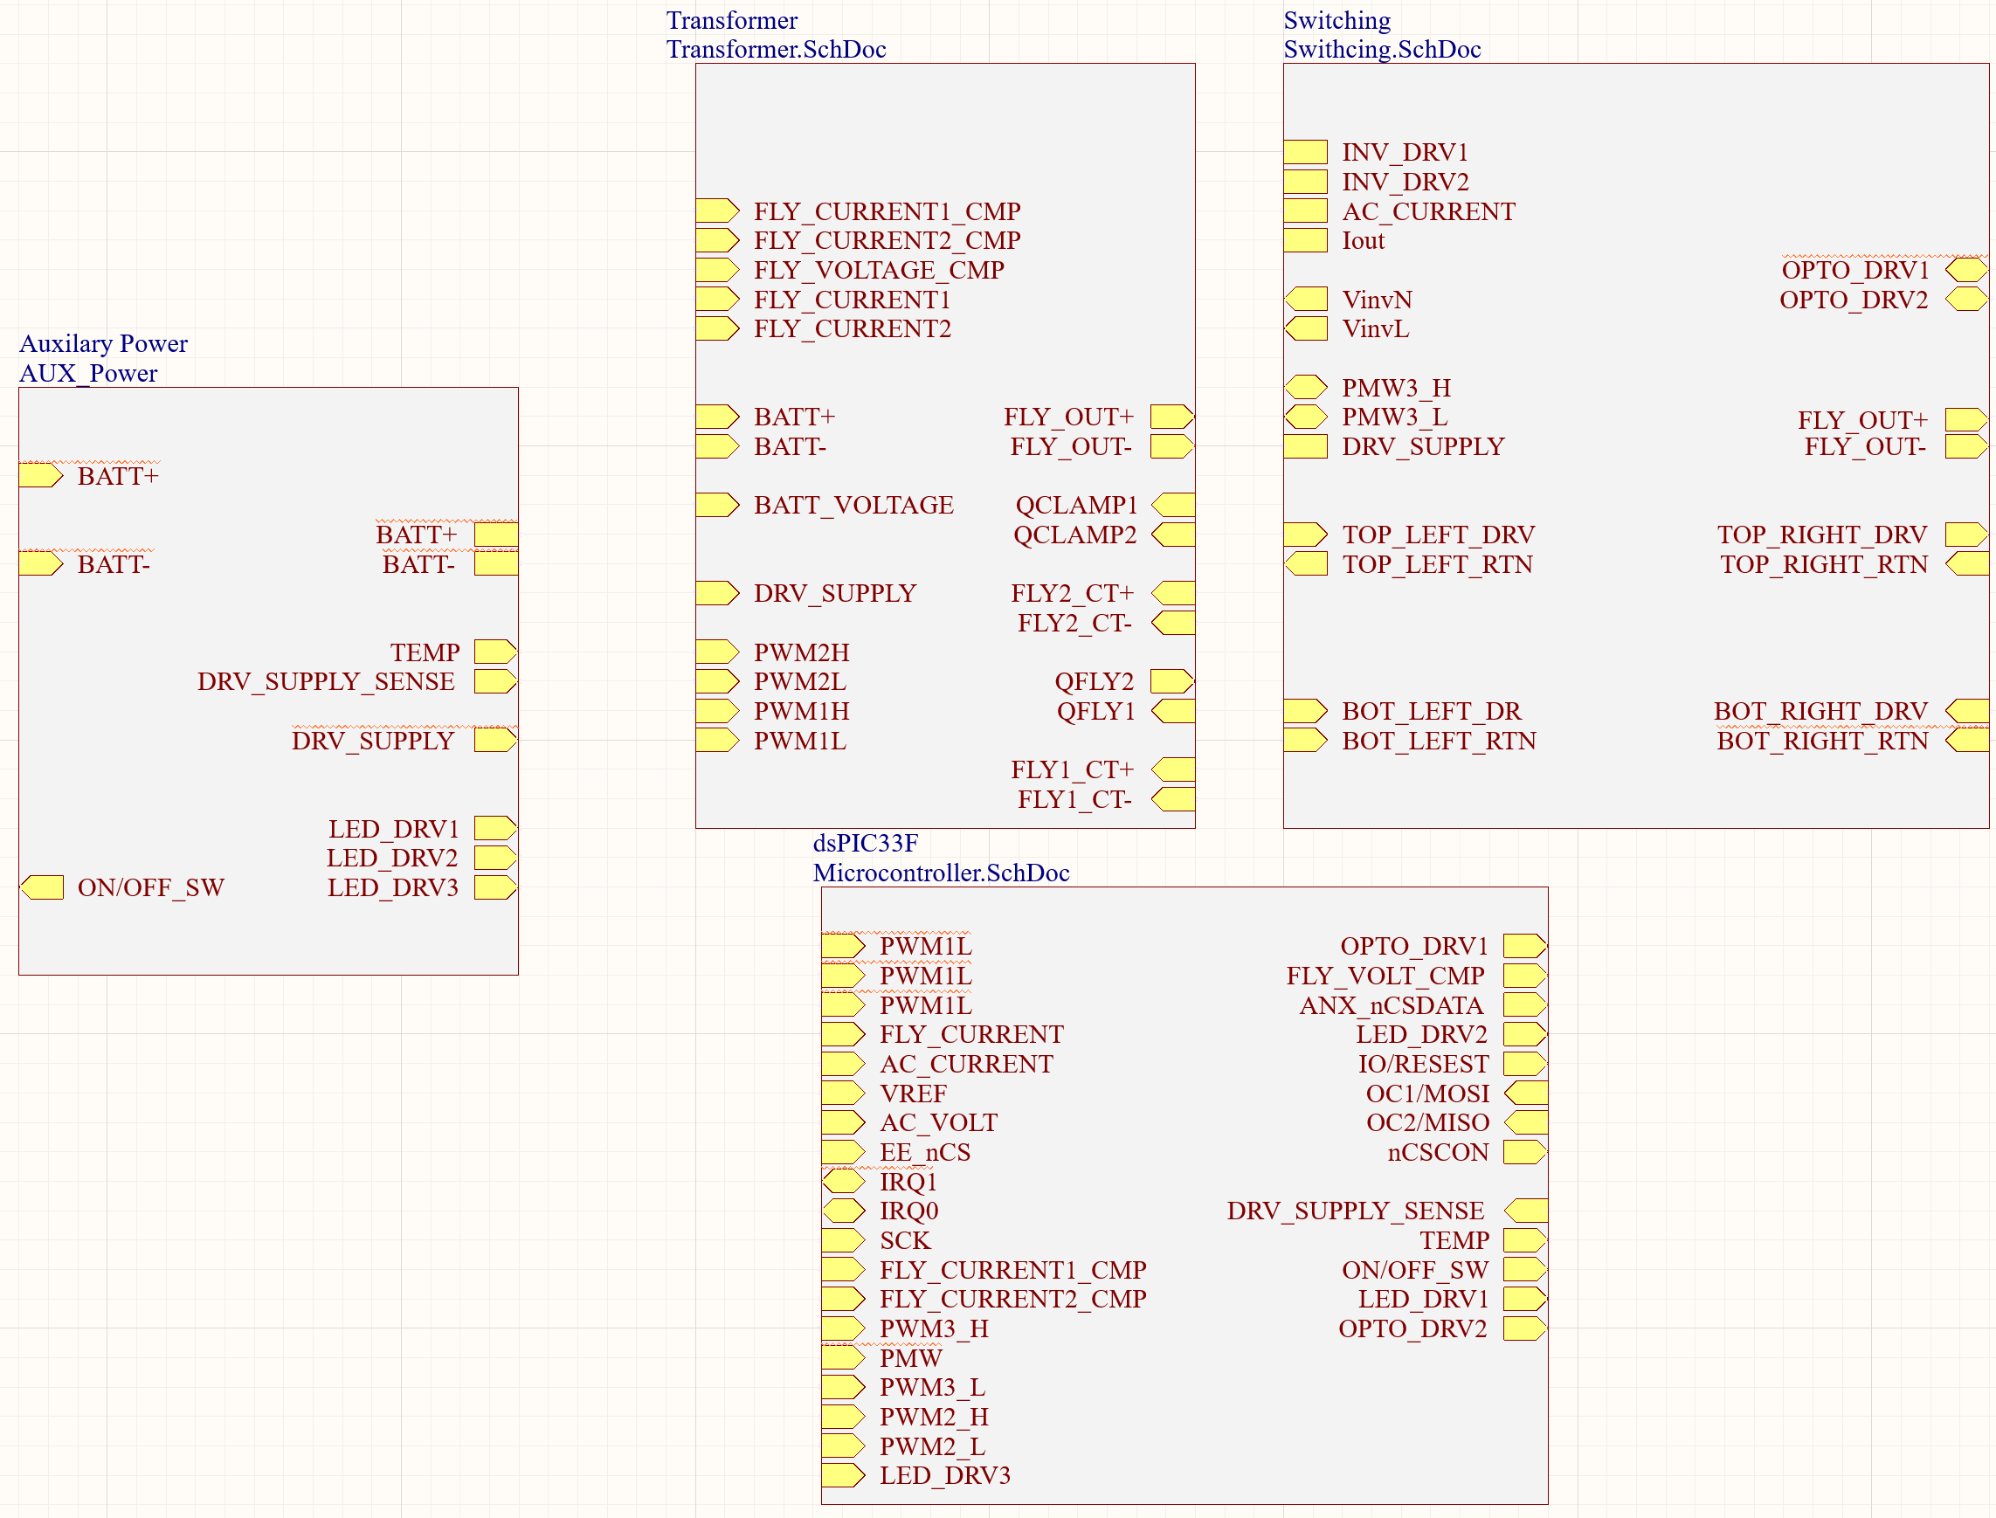
Power Inverter Jeb Malek
Accomplishments since the last presentation 50 hrs | Ongoing progress/problems and plans until the next presentation
Parts Ordered One Delivery Pending PCB Verification | PCB Ordered Practice Solder/Solder Procedure Solder Board E Load Validation Procedure Oscilloscope Benchmarking
Inverter Subsystem Diagram

Slide 7
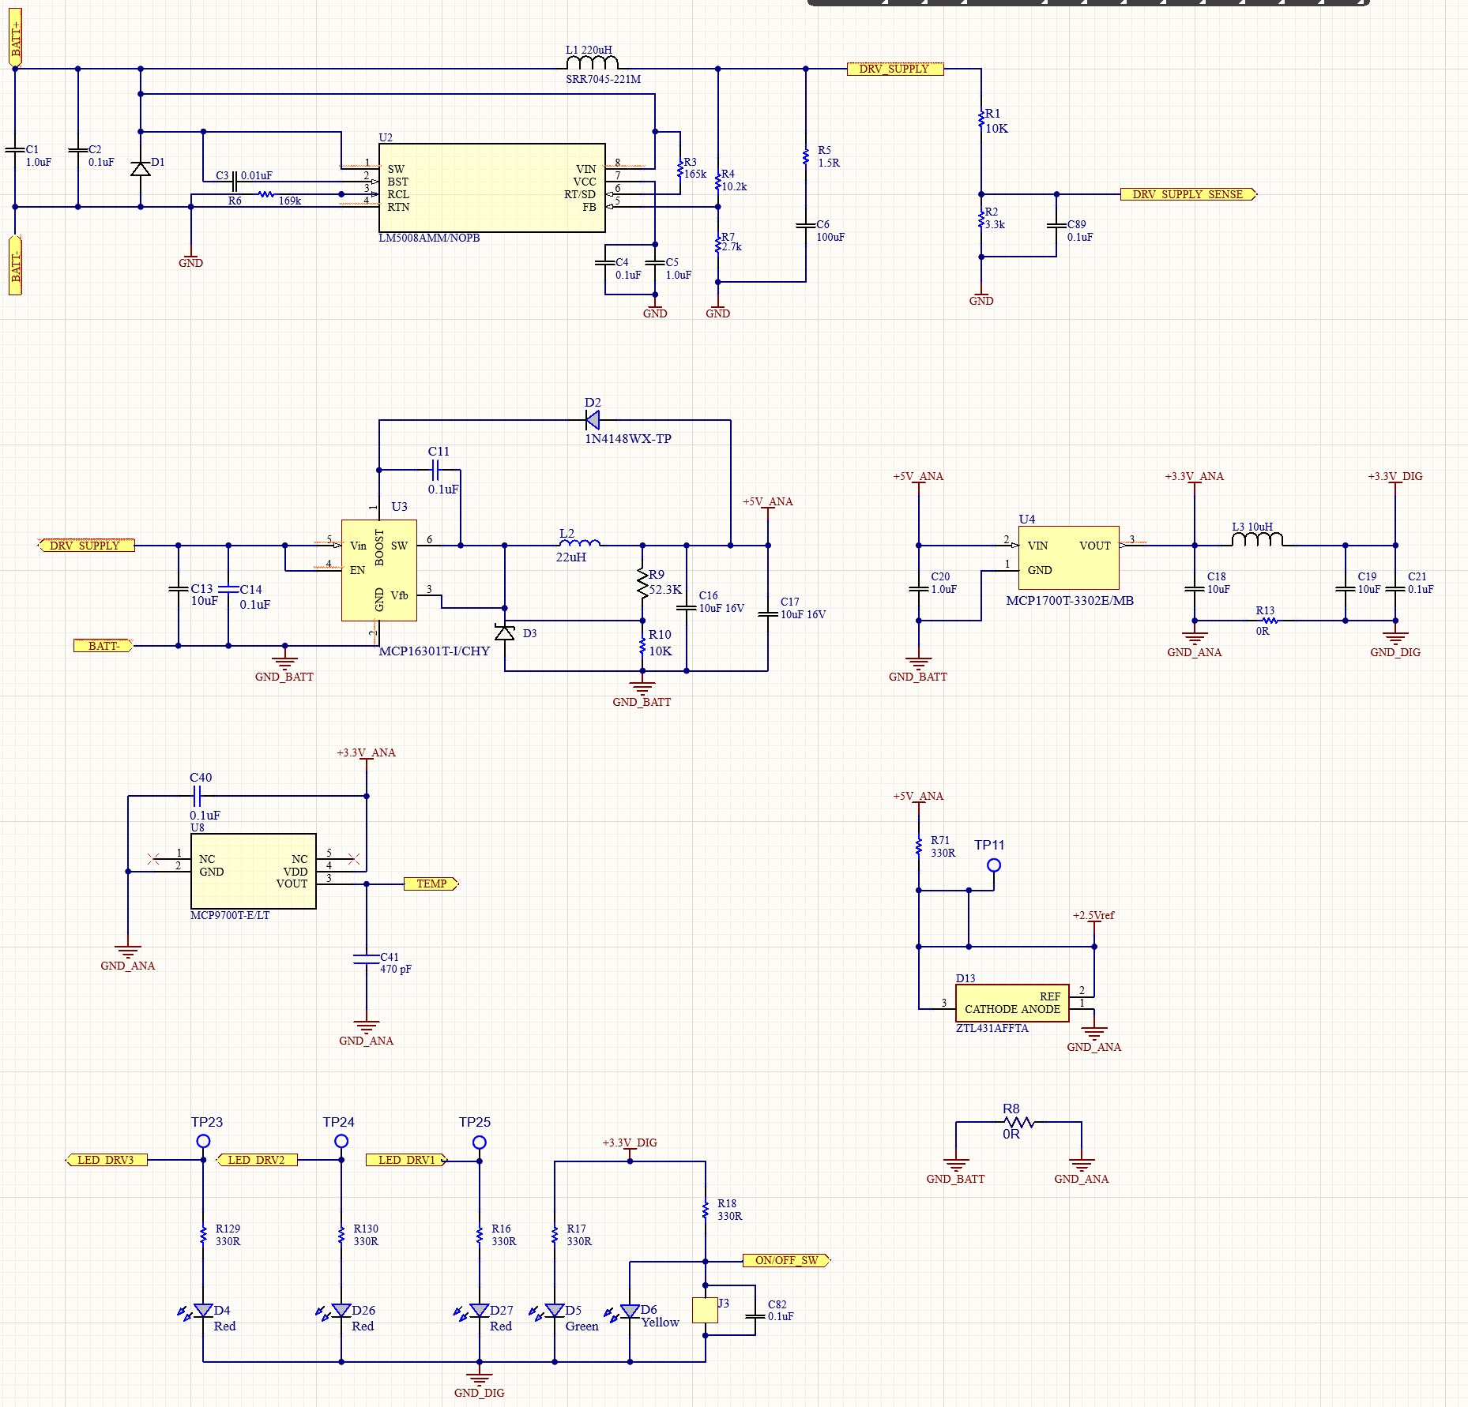
AUX Power Converter Layout
Notes:
AND operator for signal at particular timing, comparator , using a triangular wave with , using the comparator and the triangle wave , pulses can be created

Slide 8
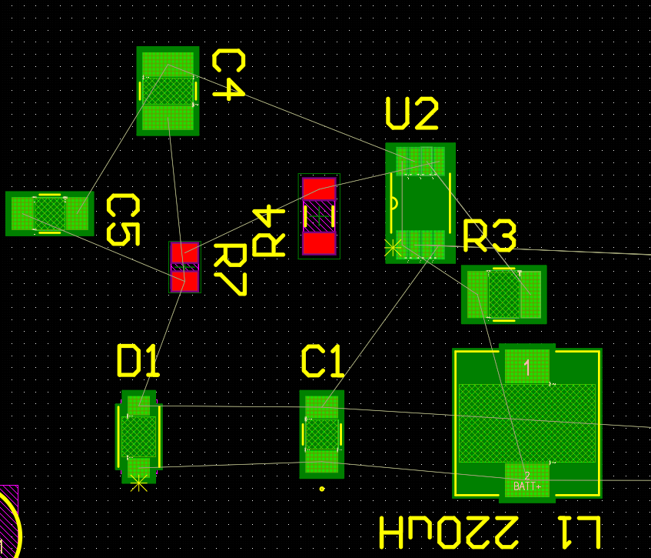
AUX Power PCB Layout
Notes:
AND operator for signal at particular timing, comparator , using a triangular wave with , using the comparator and the triangle wave , pulses can be created

Slide 9
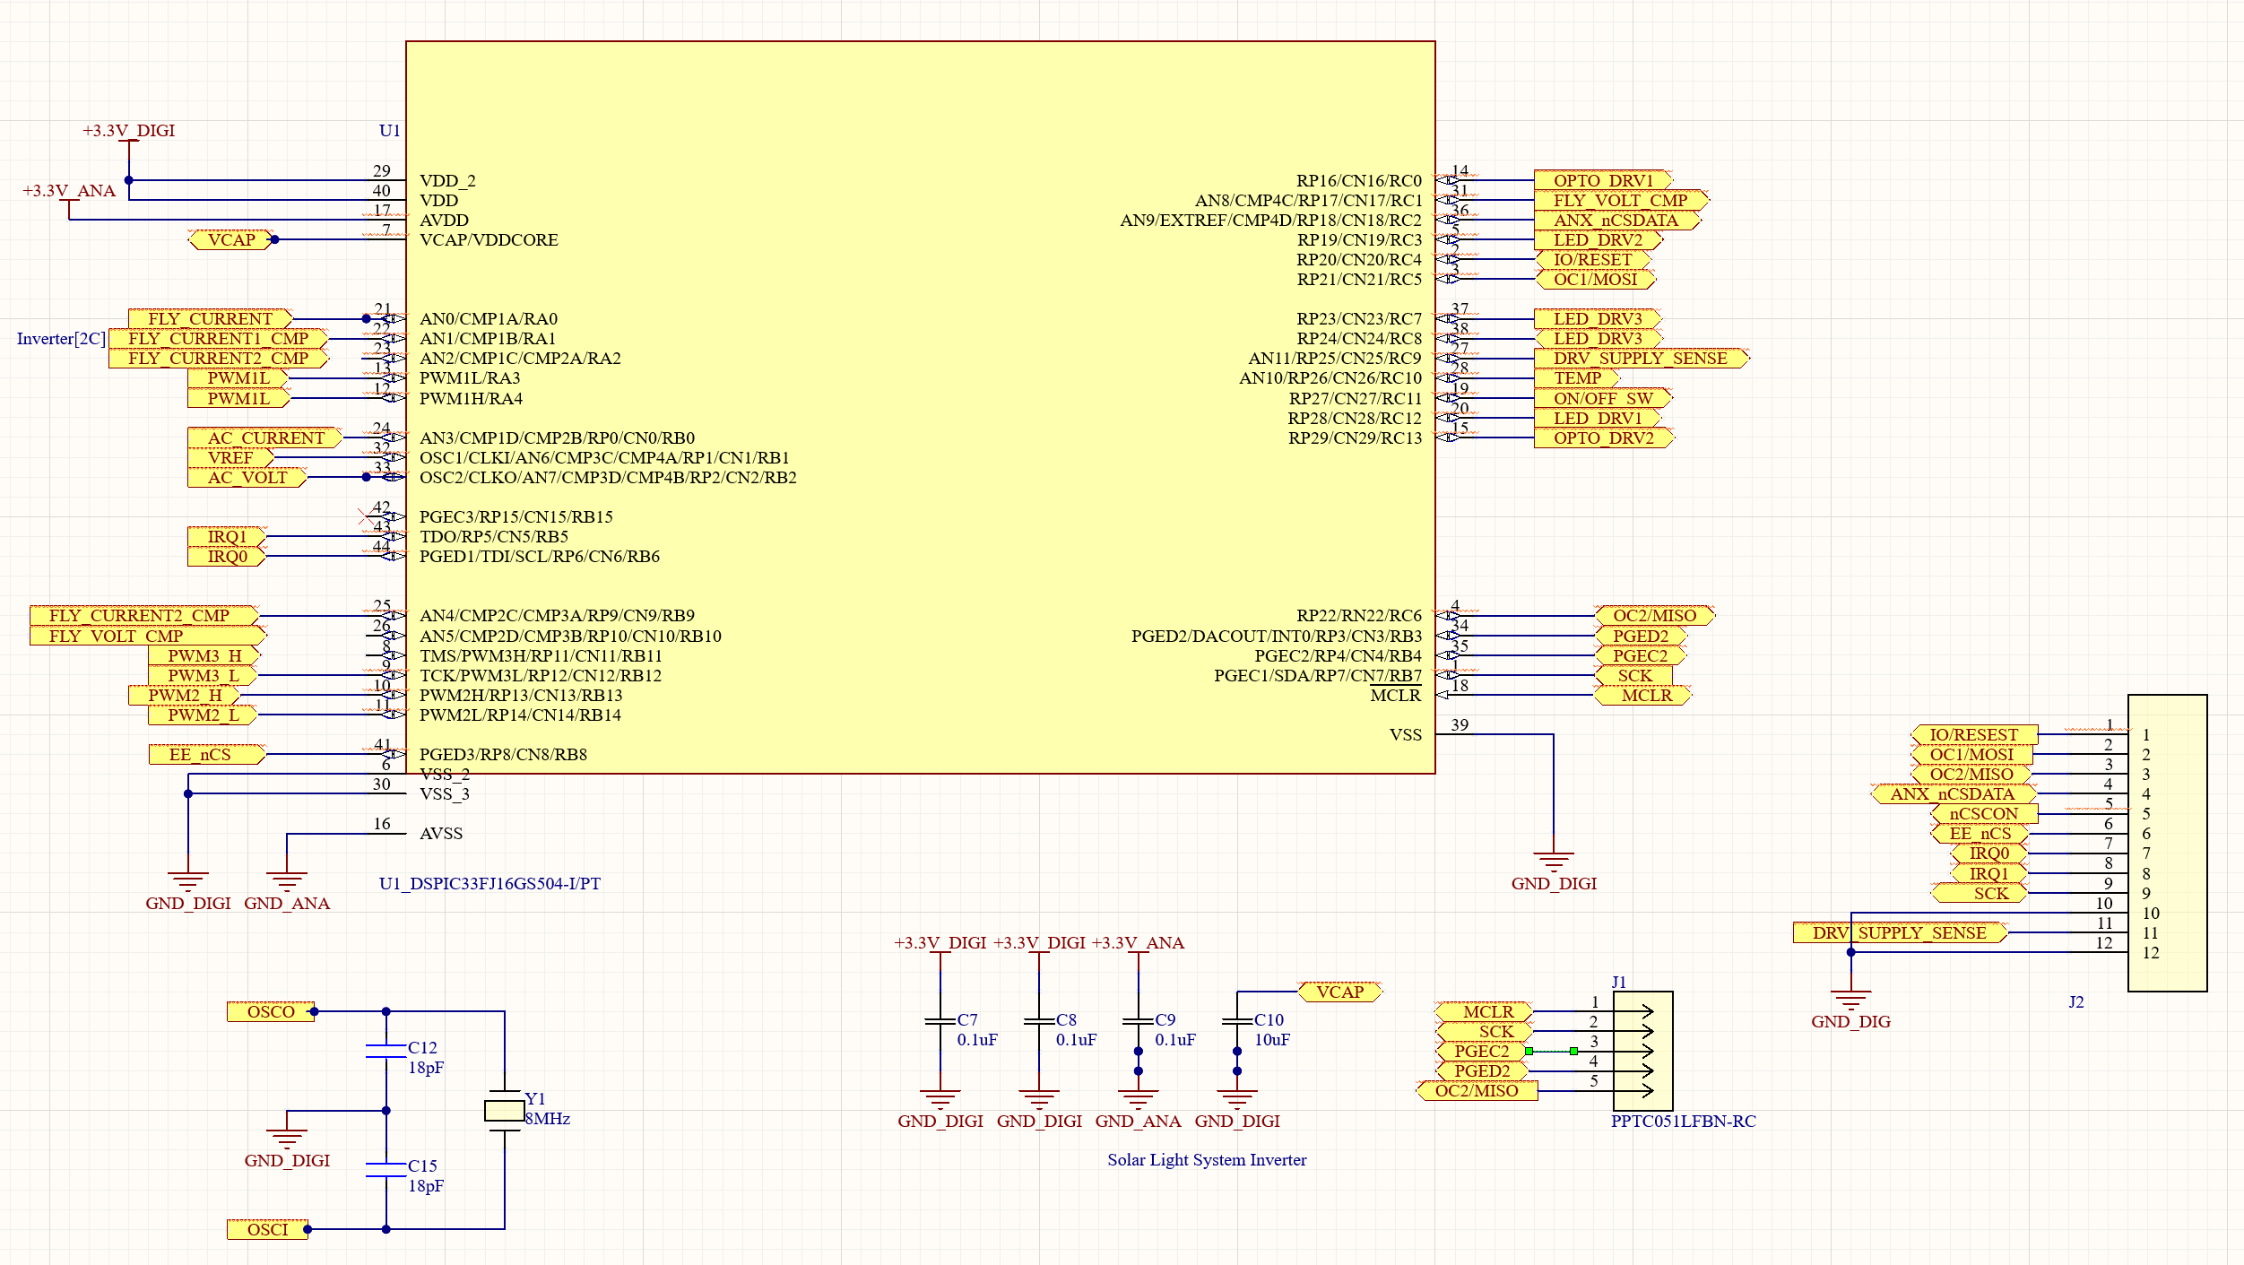
Microcontroller Layout
Notes:
AND operator for signal at particular timing, comparator , using a triangular wave with , using the comparator and the triangle wave , pulses can be created

Slide 10
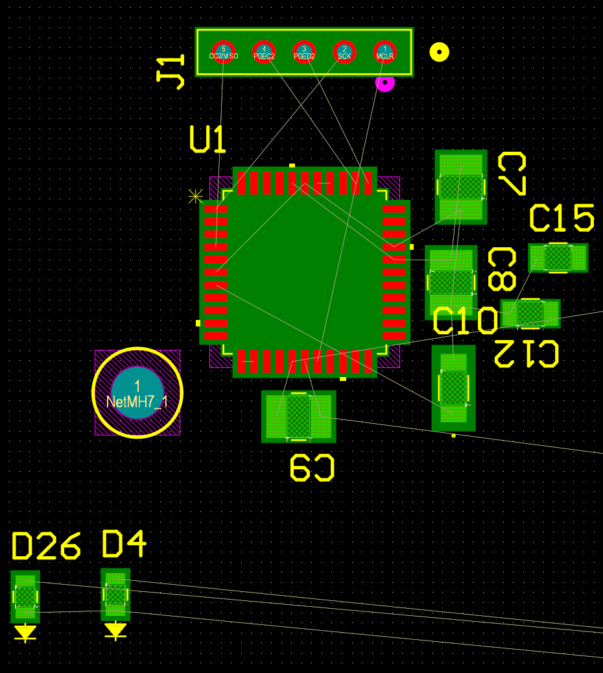
Transformer PCB Layout
Notes:
AND operator for signal at particular timing, comparator , using a triangular wave with , using the comparator and the triangle wave , pulses can be created

Slide 11
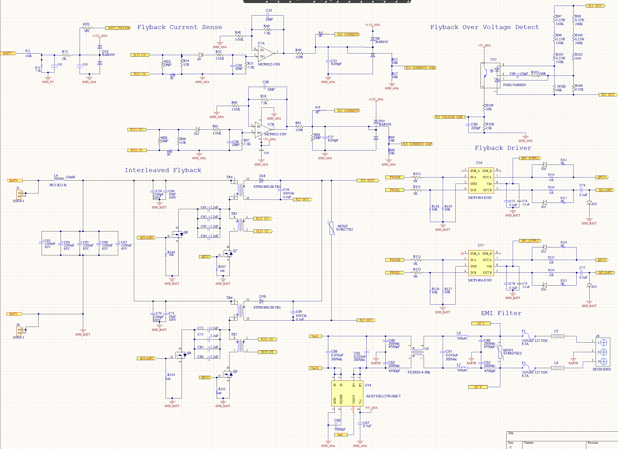
Transformer Layout
Notes:
AND operator for signal at particular timing, comparator , using a triangular wave with , using the comparator and the triangle wave , pulses can be created

Slide 12
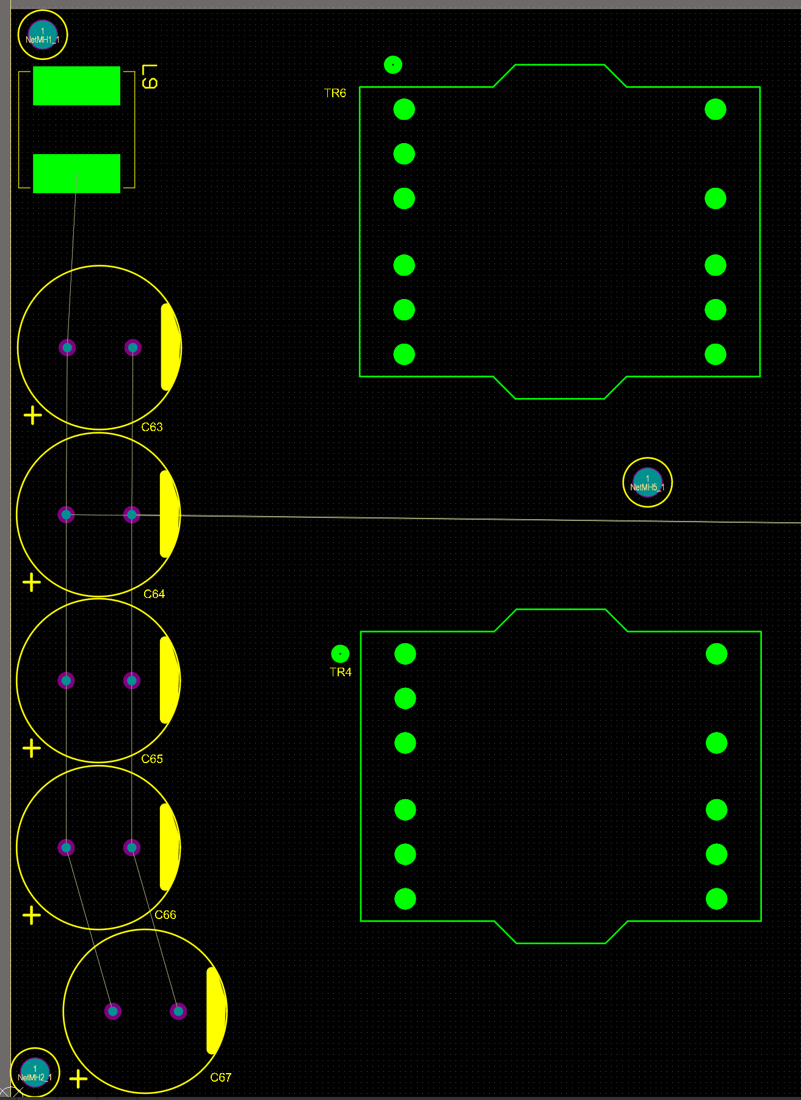
Transformer PCB Layout
Notes:
AND operator for signal at particular timing, comparator , using a triangular wave with , using the comparator and the triangle wave , pulses can be created

Slide 13
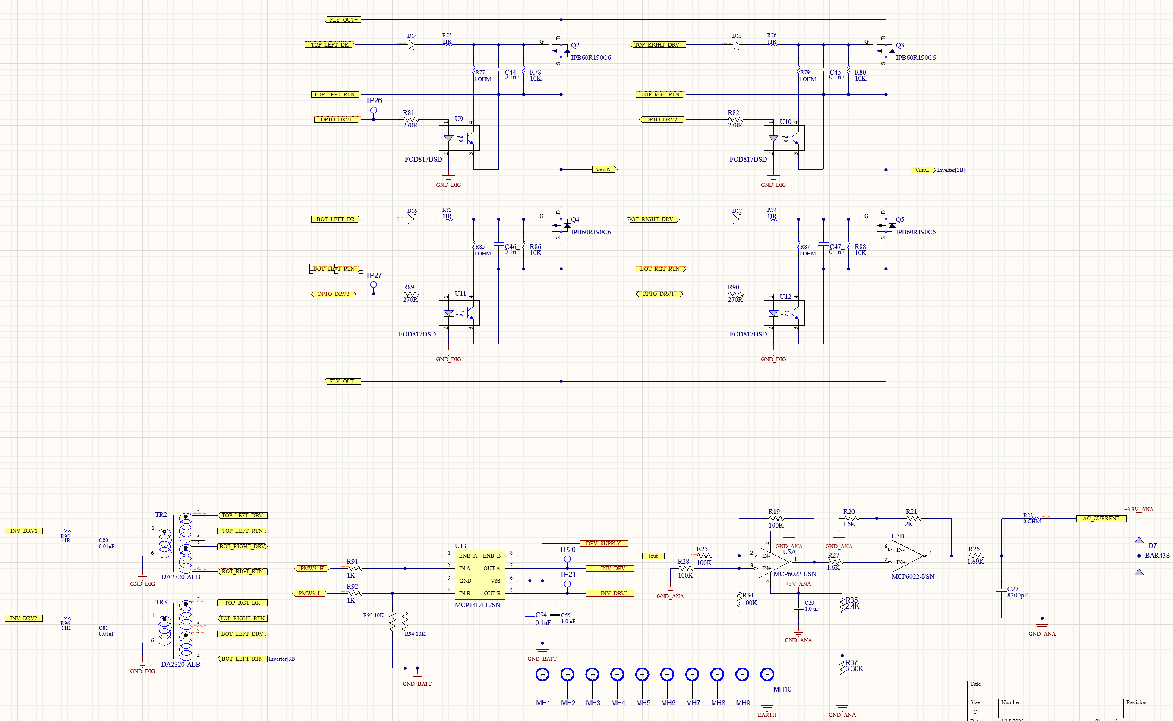
Switching Layout
Notes:
AND operator for signal at particular timing, comparator , using a triangular wave with , using the comparator and the triangle wave , pulses can be created

Slide 14
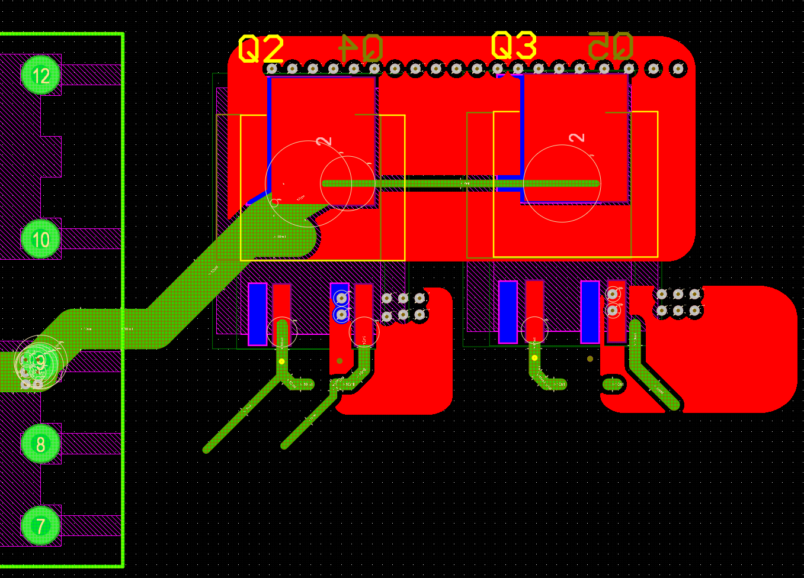
Switching PCB Layout
Notes:
AND operator for signal at particular timing, comparator , using a triangular wave with , using the comparator and the triangle wave , pulses can be created

Slide 15
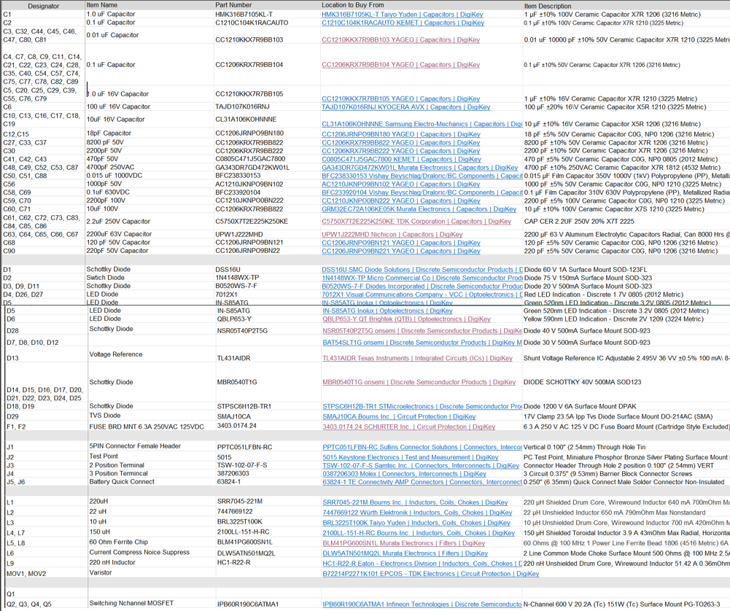
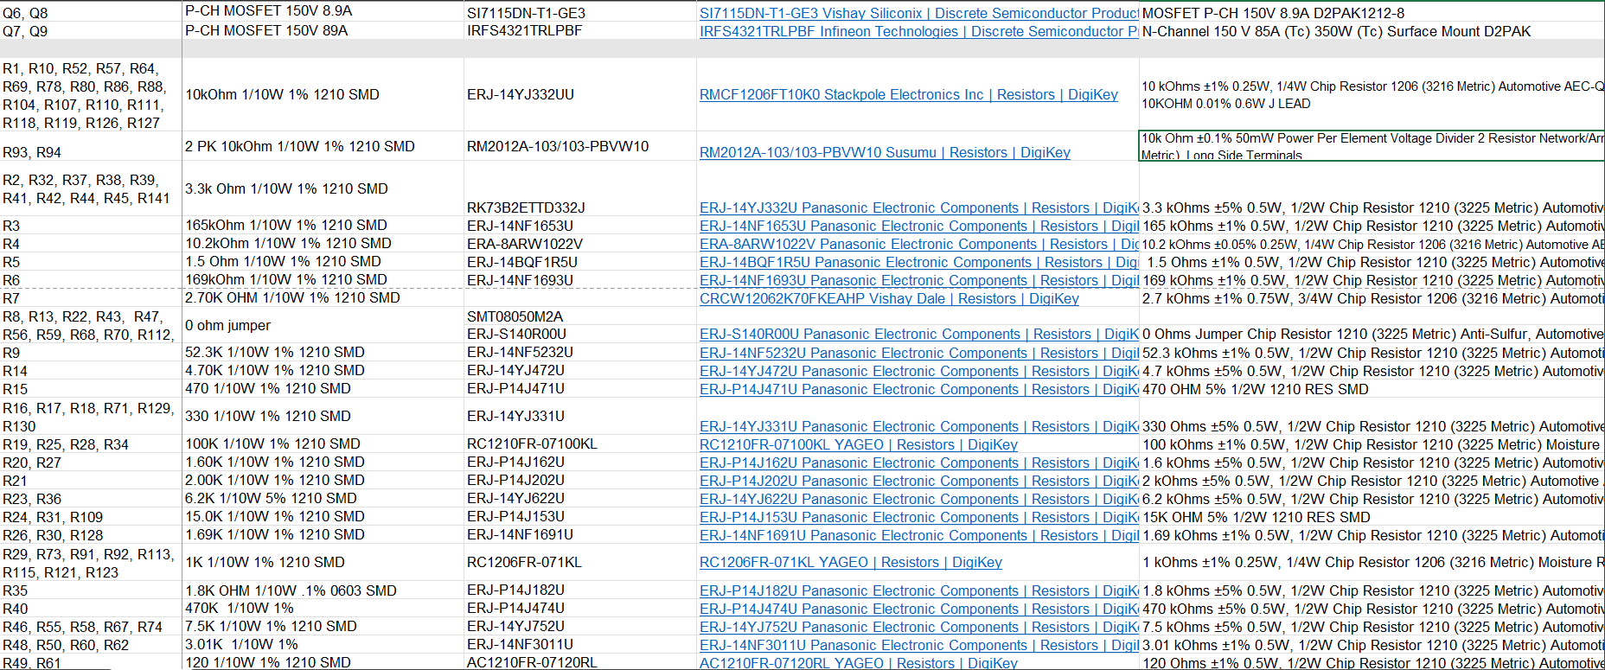
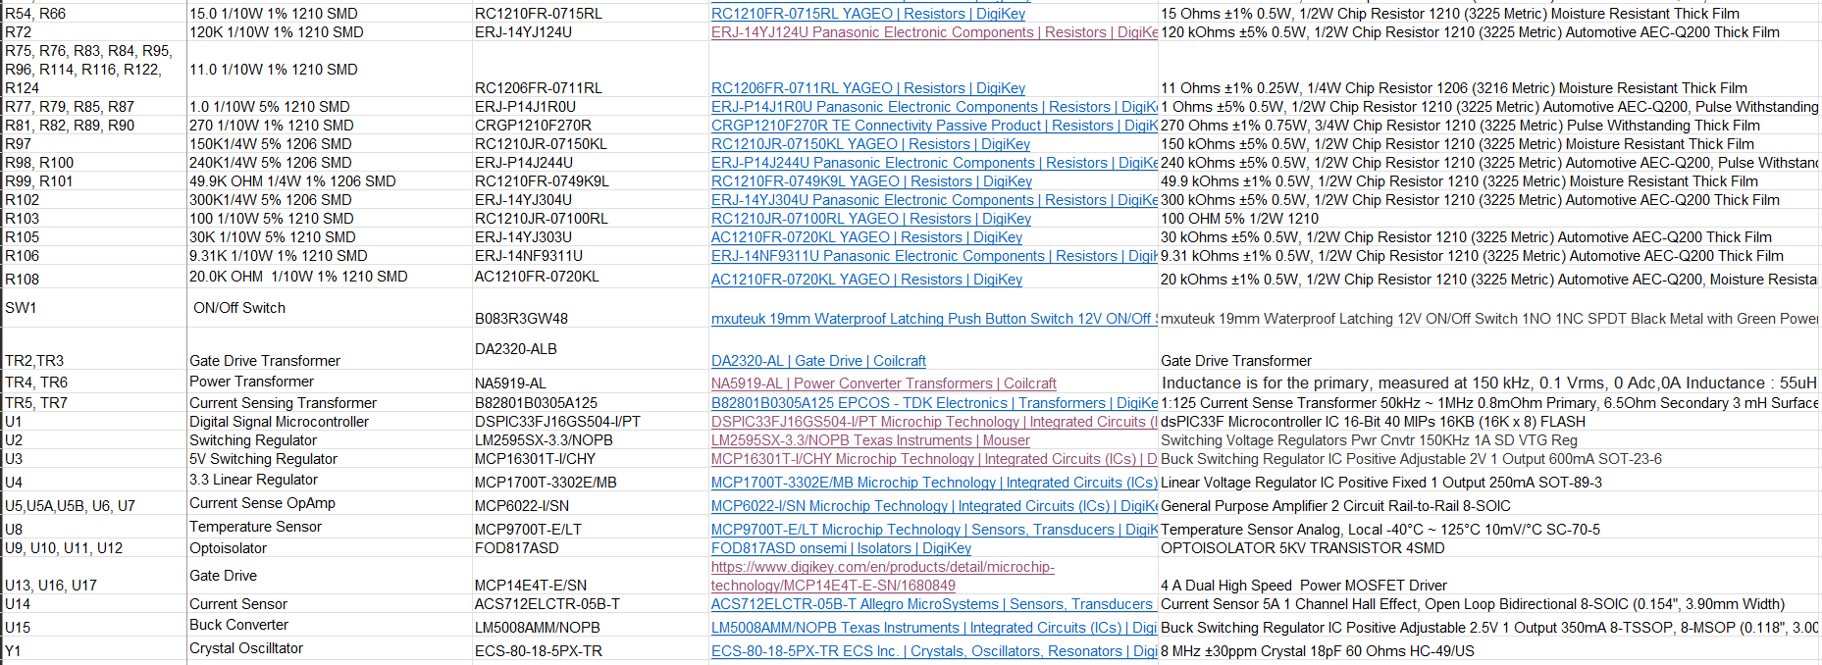
Part List
Notes:
50 percent on 50 percent off, half on , half off

Slide 16
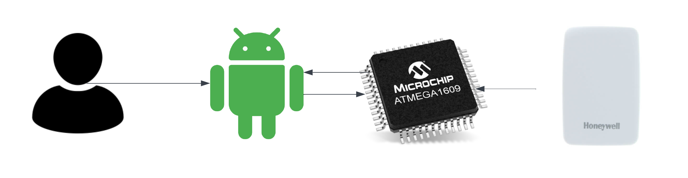
Mobile Application
Provides primary user interface for SLS
Programmed with Kotlin through Android Studio
Set user preferences, display battery/light data, display weather data
Connects to microcontroller serial port
Bluetooth connection

Slide 17
Android Josh George
Accomplishments throughout 403 | Ongoing progress/problems and plans until the next presentation
Designed Logo Cleaned Up Home Screen UI Four Buttons Navigating to Screens Color Theming About Screen Battery Level Screen Lighting Preferences Screen User Settings Screen Dark Theming | Obtain MCU Input Through Bluetooth Integrate Date/Time and Language Flesh Out Lighting Preferences Flesh Out User Settings

Slide 18
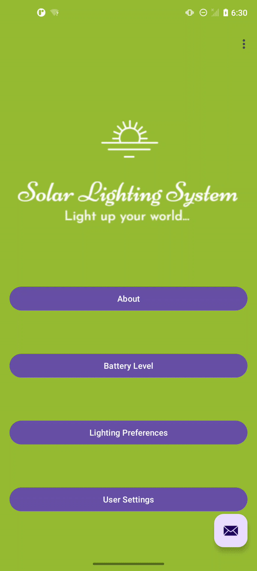
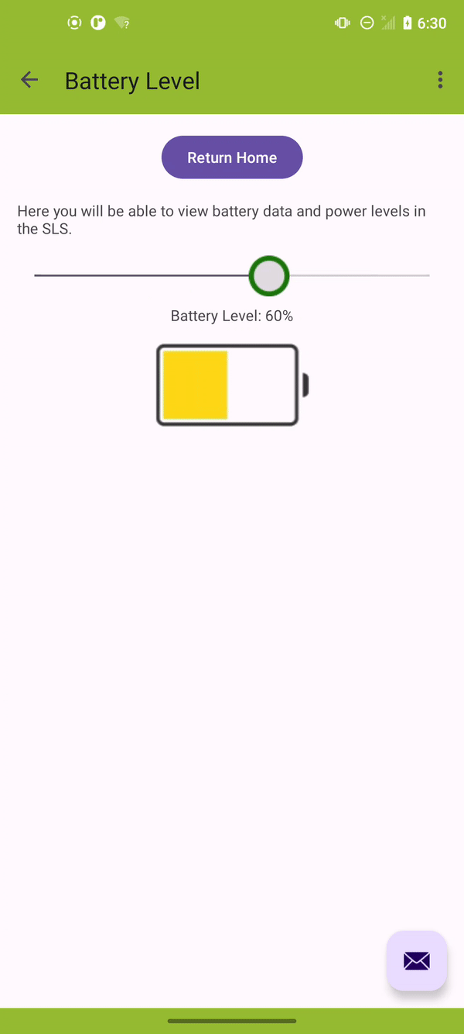
Mobile App

Slide 19
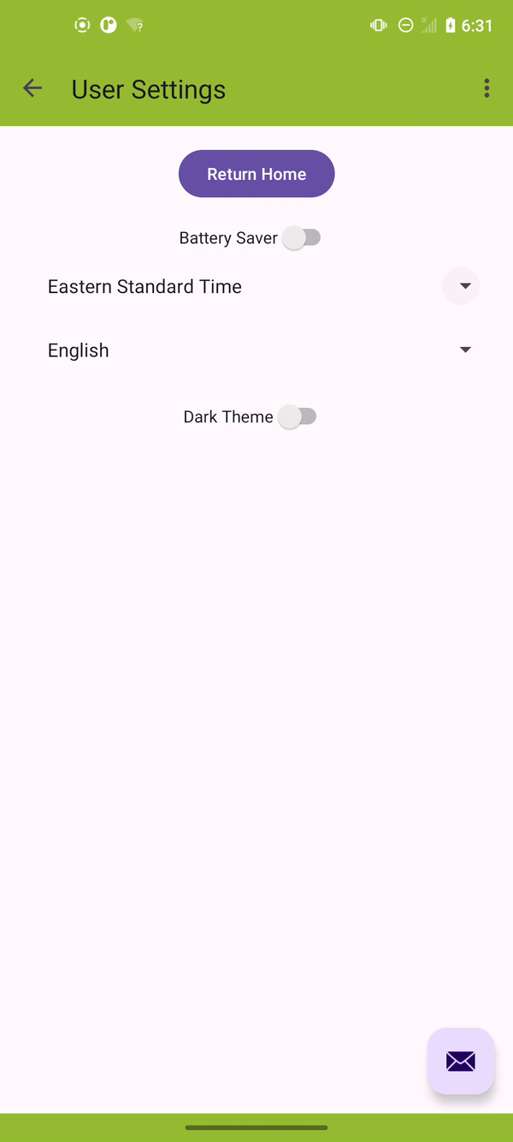
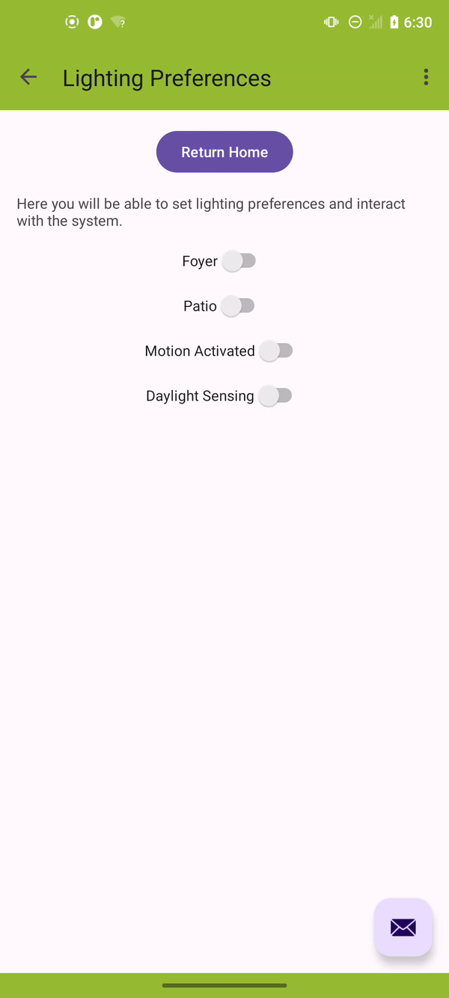
Mobile App

Slide 20
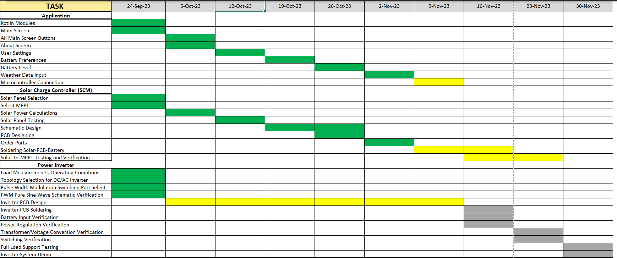
Execution Plan

Slide 21
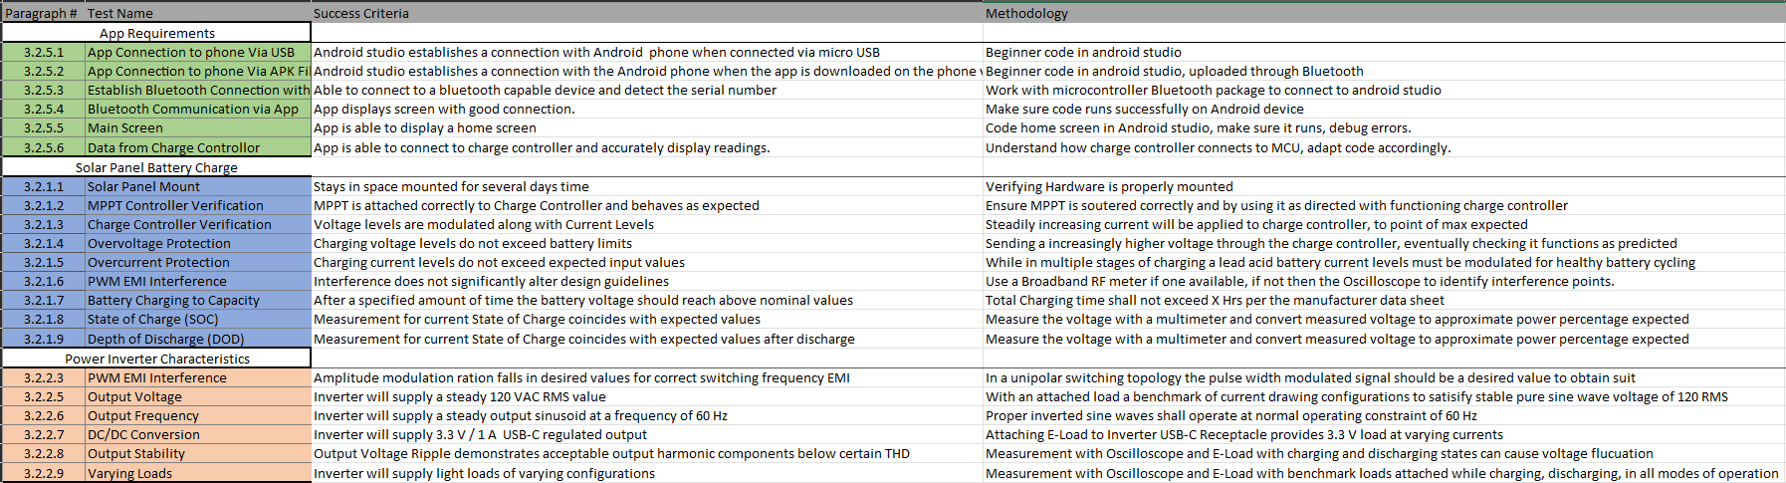
Validation

Slide 22
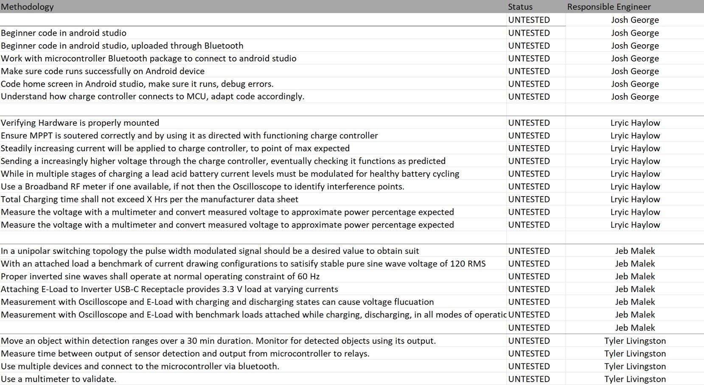
Validation

